Slide 1
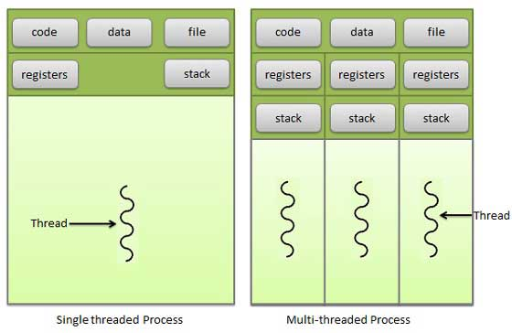
Threads
Thread: it is a light weight process
Thread address space is associated with process address space.
Thread contains limited no of instructions
by default every process will contain only one thread

Slide 2
Sinlgle Thread: If the process is blocked CPU has to wait until it’s unblock. Here CPU is waiting for long time, to over come this problem we are using multi thread.
Multi Thread: Process is divided into several tasks. each task is called as a thread.
execution time is fast. we can achieve concurrency. parallelly running multiple threads.
code,data,files sections share all the threads
each thread have own register and stack;
whenever the thread is blocked the next instructionis stored in the corresponding thread register.
advantages of mulithreading: 1. responsiveness
2. resource sharing
3. less economy compare to multiprocess
4. not required additional address space

Slide 3
process | Thread
process is heavy weight | Thread is a light weight
Process switching needs interaction with os | Thread switching doesn't need interaction with os
creation of process takes more time | creation of thread takes less time
termination of process takes more time | termination of thread takes less time
communication takes more time | less time
doesn't share the data | data is shared
error on process doen't affect other process | error on thread effect another
if one process is blocked no other process can execute until the first process is unbloked | one thread is blocked or waiting other thread can execute
ex:ATM machine | ex:serices of ATM

Slide 4
Types of threads: user level threads and kernel level threads
User level threads: managed by user and not required any os support
Kernel level threads: managed by os and os support required
there should a mapping b/w user level threads to kernel level threads in order to execute the user level threads.

Slide 5
User level threads | Kernel level threads
Implemented by user | Implemented by kernel
context switching is easy | context switching is difficult
Multithreading is not compatible | Multithreading is compatible
If one thread is in blocking state all the remaining will be in blocking state | if any thread is in blocking state all other threads will not be in blocking state
Doesn't recognized by os | recognized by os
Thread management is easy | Thread management is difficult
Thread library code is available for creation,destroy and transfer etc | system calls for creation
h/w support not required | H/W support is required
Runs on any os | runs on os specific
created in user space | created in kernel space

